Slide 1

YENEPOYA INSTITUTE OF TECHNOLOGY
NBA-Accredited : B.E (CSE & ME)
(Approved by AICTE, New Delhi, Affiliated to Visvesvaraya Technological University, Belgavi)
Department of Information Science and Engineering
Internship Presentation On
MOVIE RECOMMENDATION SYSTEM
Praneeth
7th sem ISE
4DM20IS034
Date:11/11/1111
Under the guidence of
Prof.Rashmi P C
Page 1

Slide 2
INTRODUCTION
Personalized movie recommendations based on user preferences and movie attributes.
Focus on intrinsic movie characteristics for tailored suggestions.
Comprehensive approach includes data acquisition, preprocessing, and algorithm selection.
Potential user interface for seamless interaction and enhanced accessibility.
Page 2

Slide 3

ABOUT COMPANY
Page 3

Slide 4
ABOUT COMPANY
ZEPHYR TECHNOLOGIES is a software company delivering high quality, cost effective, reliable result-oriented web and e-commerce solutions on time for a global clientele.
They develop unique web solutions which ensure increased efficiency and competitive advantage for your business and thus to your end- users
Page 4

Slide 5
METHODOLOGY
RECOMMENDER SYSTEM
A recommender system is a type of information filtering system that predicts and suggests relevant items or content to users based on their preferences and behavior.
They rely on techniques like data mining, machine learning, and natural language processing to understand and respond to user preferences, creating a personalized and tailored experience.
The ultimate goal of recommender systems is to assist users in discovering and engaging with content that aligns with their interests, ultimately increasing user satisfaction and driving business success.
Page 5

Slide 6
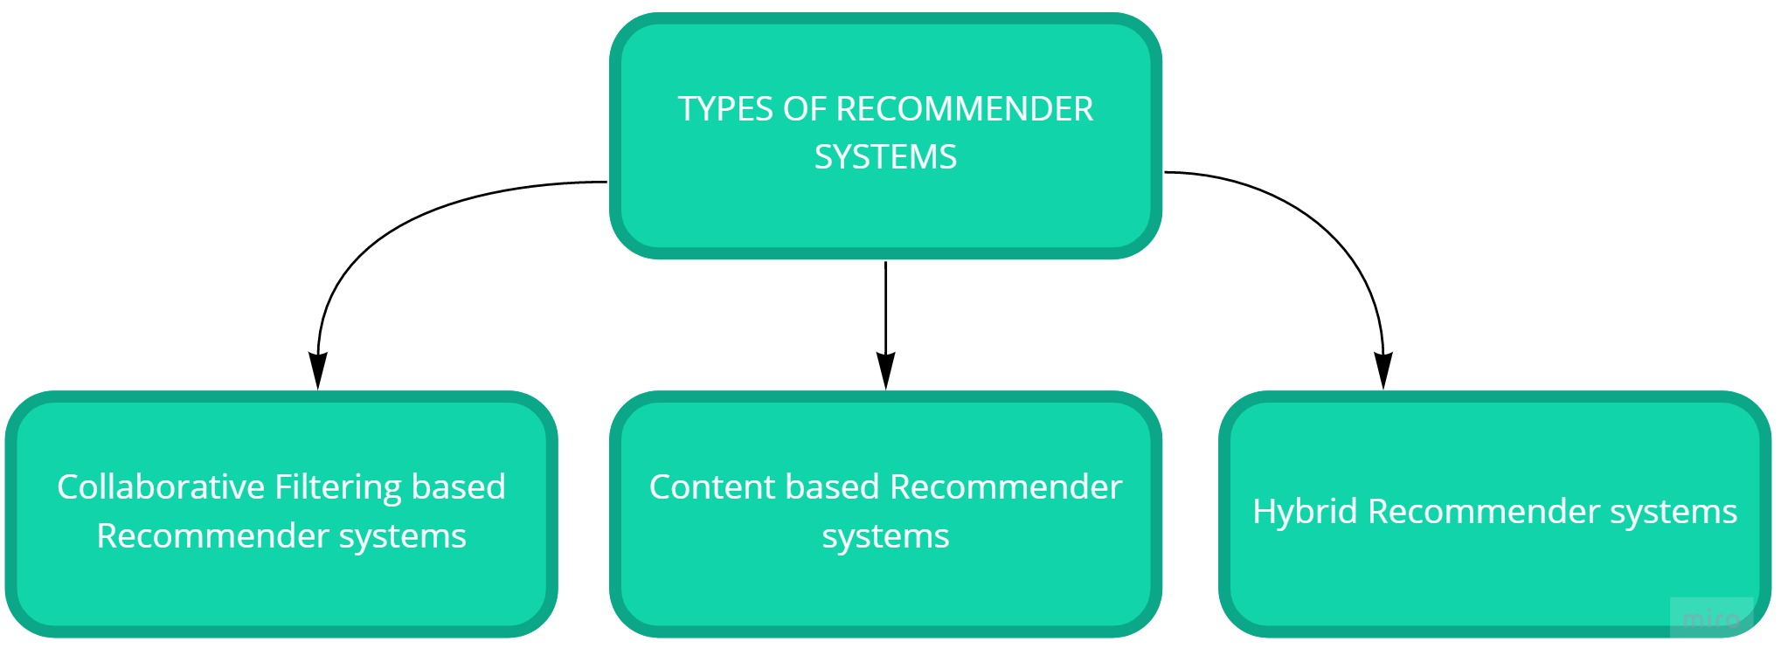
RECOMMENDER SYSTEM
Page 6

Slide 7
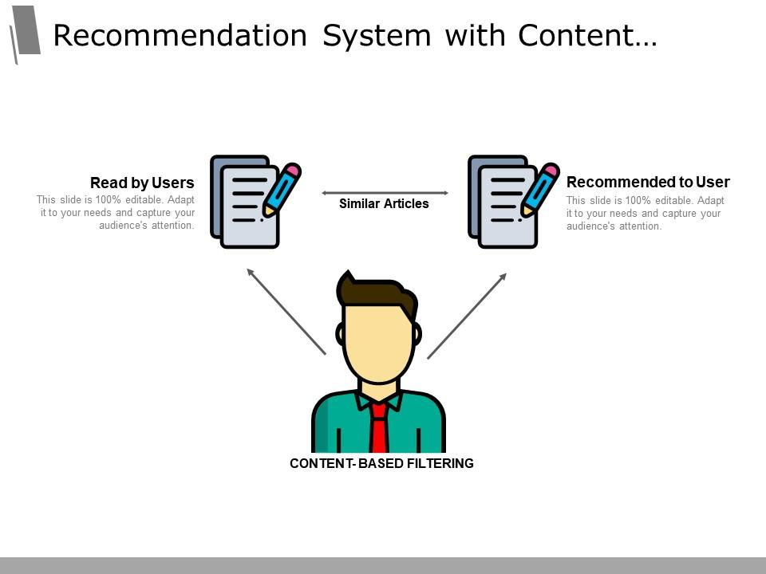
1. CONTENT BASED RECOMMENDER SYSTEM
Page 7

Slide 8
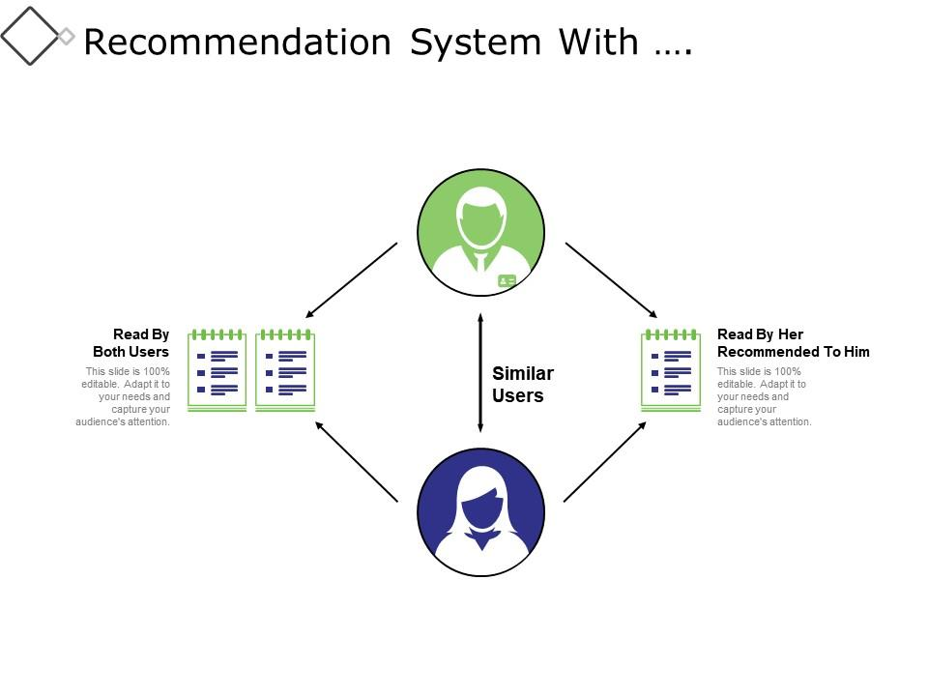
2. COLLABORATIVE FILTERING BASED RECOMMENDER SYSTEM
Page 8

Slide 9
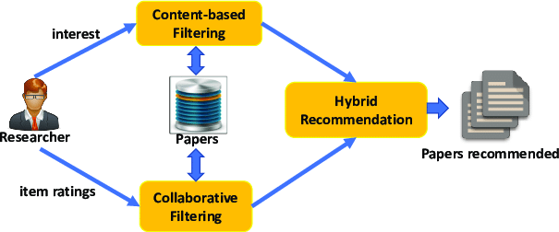
3. HYBRID RECOMMENDER SYSTEM
Page 9

Slide 10
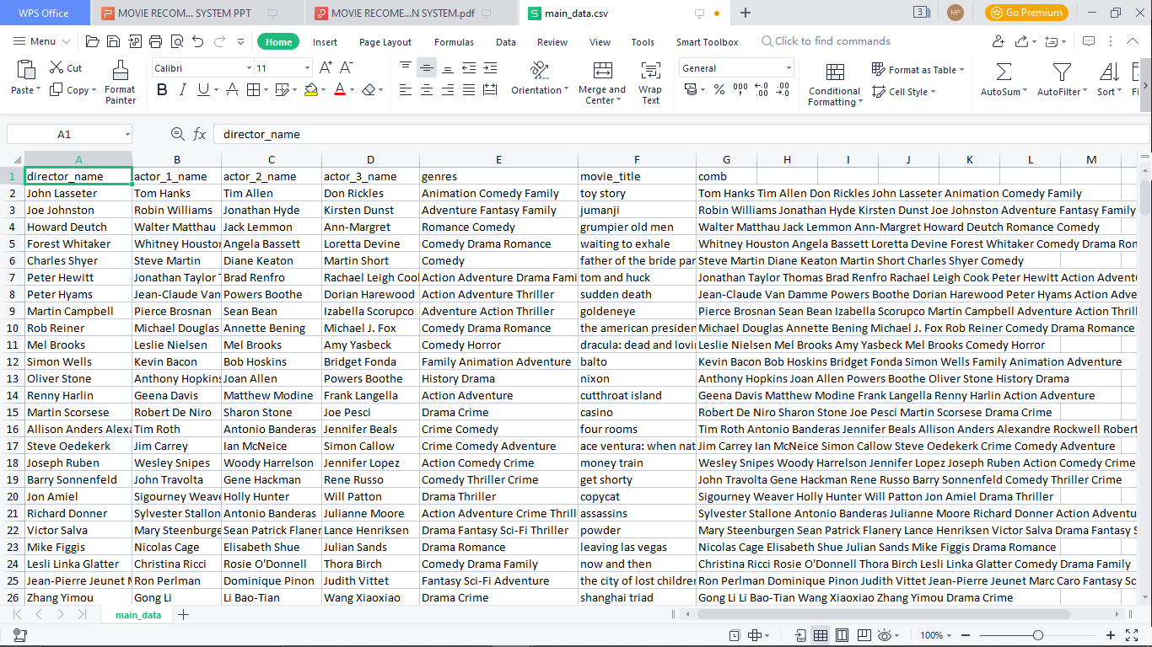
TRAINED DATA SET
Page 10

Slide 11
ML PYTHON PACKAGES
Flask==2.3.2
gunicorn==19.9.0
Jinja2==2.11.3
MarkupSafe==1.1.1
Werkzeug==2.2.3
numpy>=1.9.2
scipy>=0.15.1
nltk==3.6.6
scikit-learn>=0.18
pandas>=0.19
beautifulsoup4==4.9.1
jsonschema==3.2.0
tmdbv3api==1.6.1
lxml==4.9.1
urllib3==1.26.5
requests==2.23.0
pickleshare==0.7.5
Page 11

Slide 12
ALGORITHM
Multinomial Naive Bayes Algorithm for Sentiment Analysis
TF-IDF Vectorization(Term Frequency-Inverse Document Frequency)
Training Phase
Bayes' Theorem for Classification
Cosine Similarity
Prediction Phase
Page 12

Slide 13

NAIVE BAYES ALGORITHM
Convert the given dataset into frequency tables.
Generate Likelihood table by finding the probabilities of given features.
Now, use Bayes theorem to calculate the posterior probability.
Page 13

Slide 14
TMDB API
The TMDb API, provided by The Movie Database, is a powerful tool that allows developers to access a vast amount of information related to movies and TV shows.
Accessing Movie Information
Fetching Images and Posters
Ratings and Reviews
Discovering Similar Movies
Real-Time Updates
Search and Filtering
Authentication and Security
Compliance with Terms of Use
Page 14

Slide 15
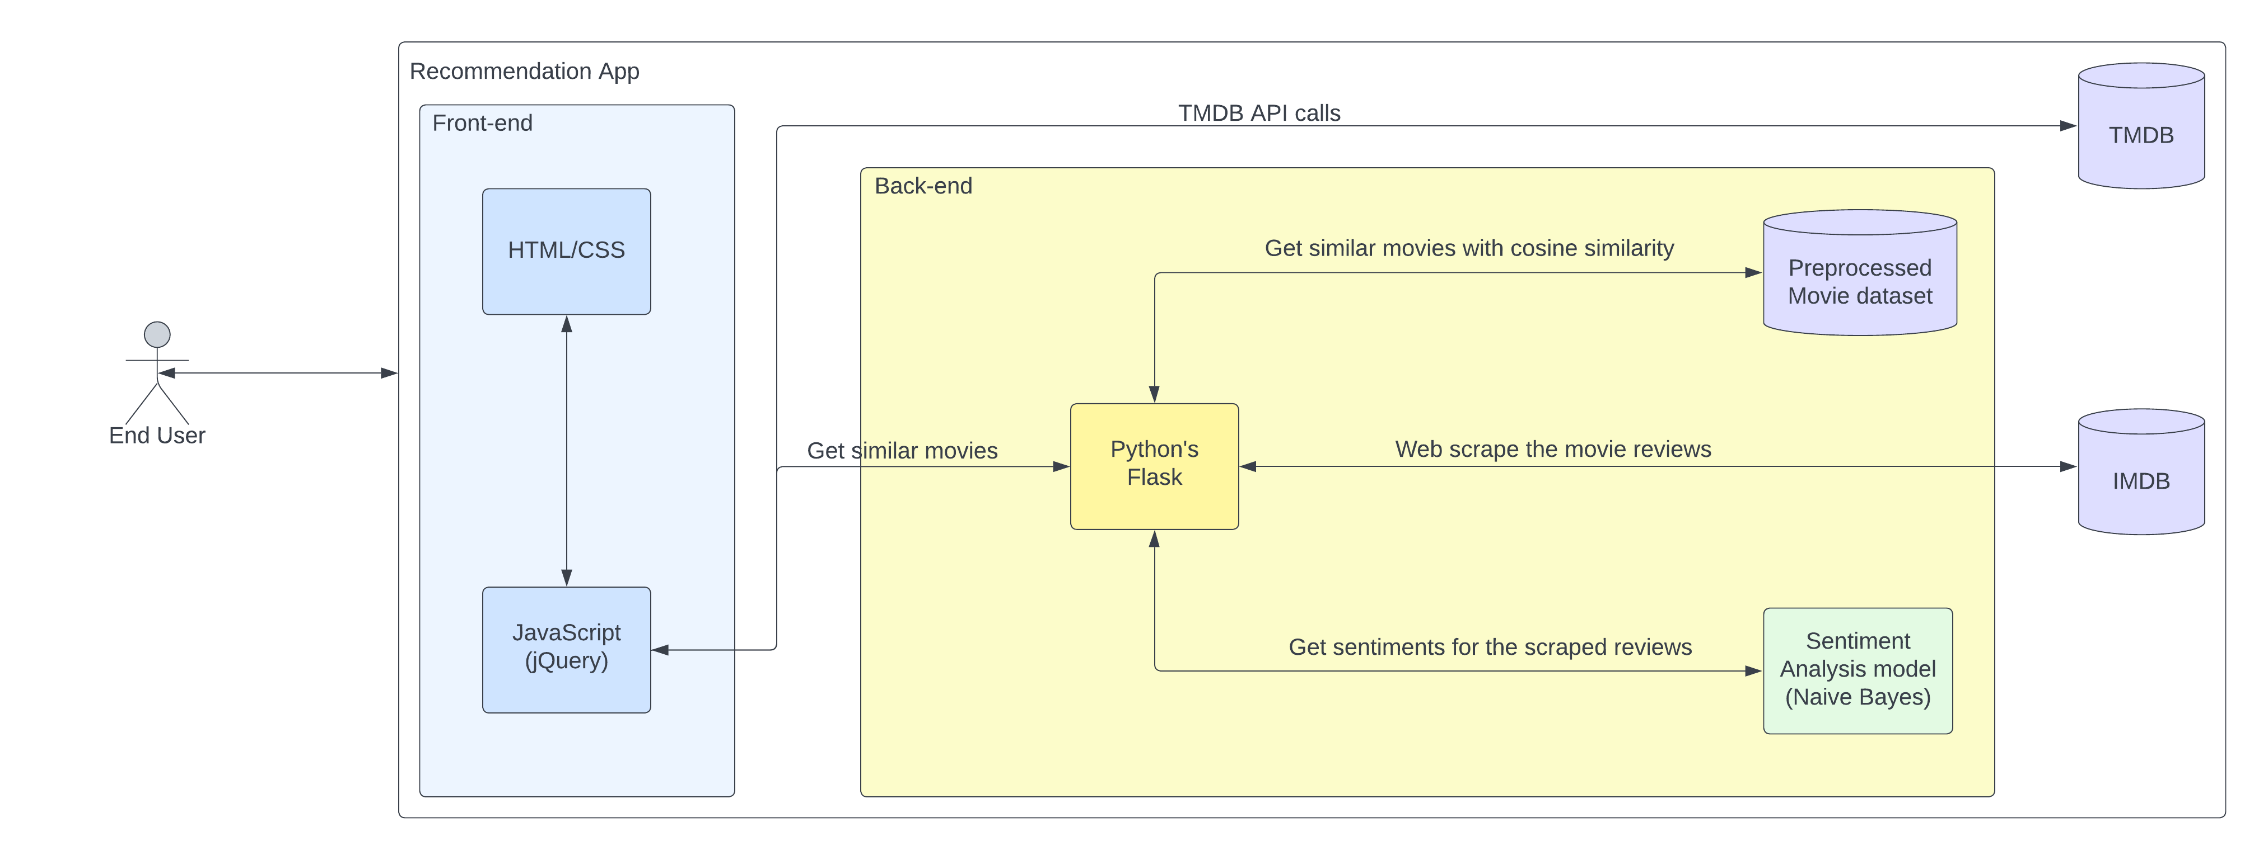
SYSTEM ARCHITECTURE
Page 15

Slide 16
DEMO
Lets start the visual studio with python as a kernel
Run the program
Copy url to browser
http://127.0.0.1:5000
Page 16

Slide 17

Page 17

